Slide 1



Slide 2
About today…
React components & Forms
Controlled Components
Uncontrolled Components
React Form

Slide 4
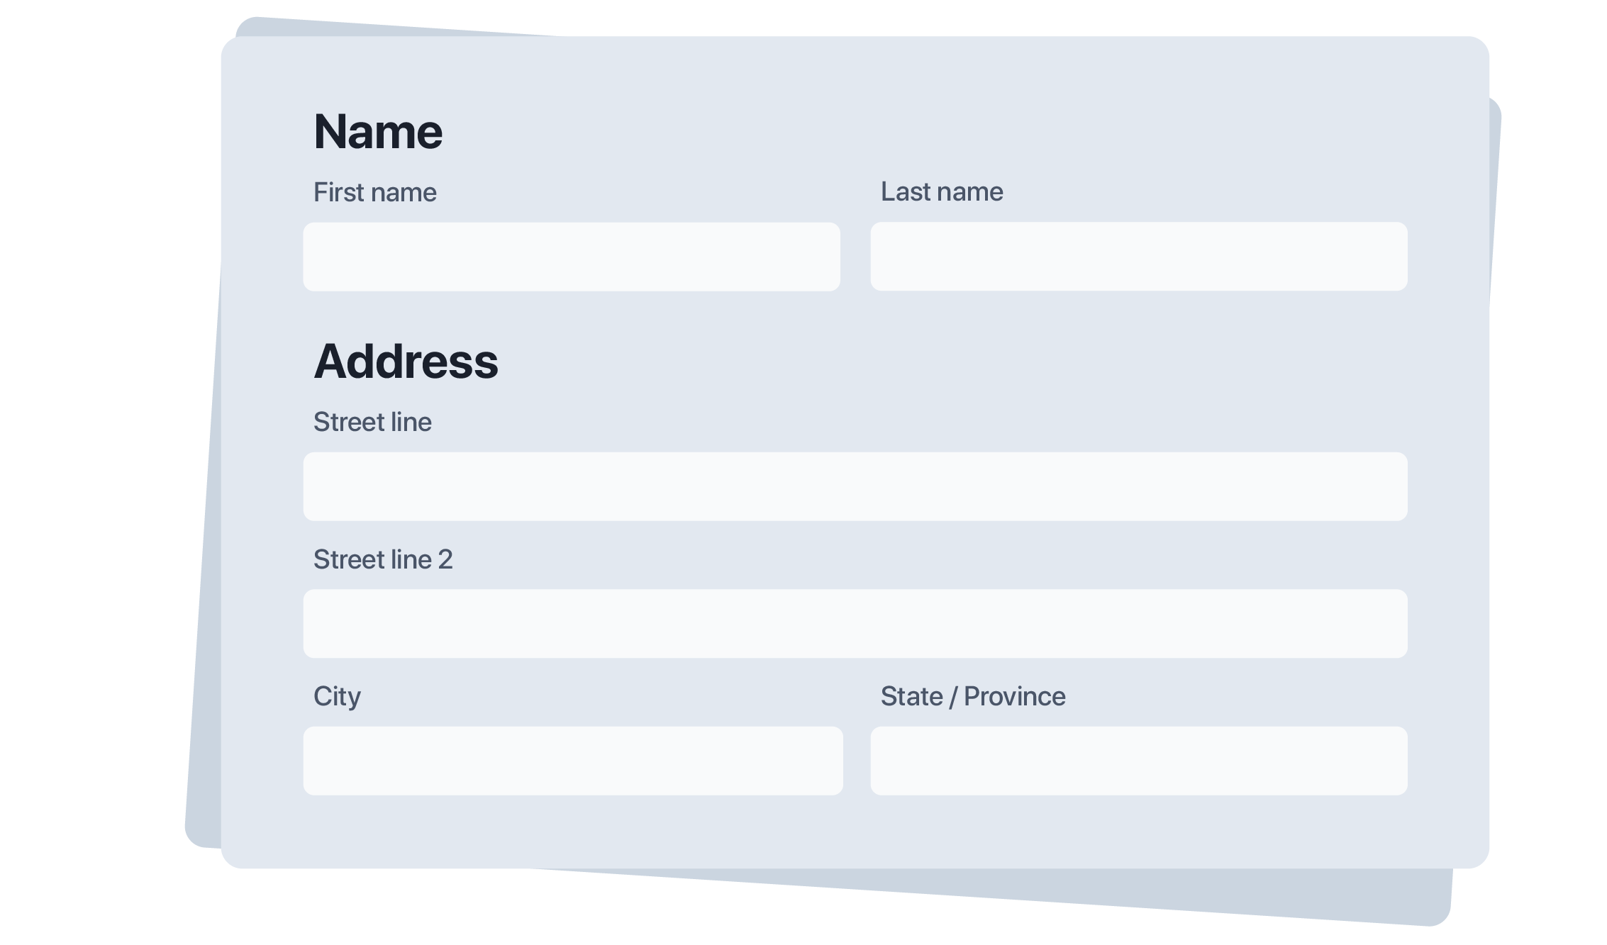
Intro to React Forms
Forms in React
Key part of user interaction and data submission
Purpose
Collect and manage user inputs efficiently
Controlled Components
Component data controlled by state
Uncontrolled Components
Component data not controlled by state,
component itself is holding data

Slide 5


Slide 6
Controlled vs. Uncontrolled Components Comparison
Controlled Components
Form data is controlled by React state
Easier to synchronize with React state
More complex to set up
Uncontrolled Components
Form data is managed by the DOM
Simpler setup for quick forms
Less control over form data and state

Slide 7
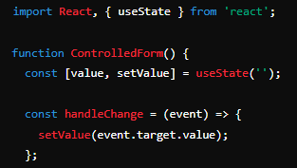
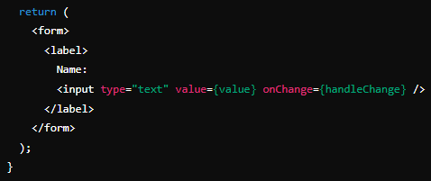
Controlled Components
Definition
Components where form data is controlled by the React state
Advantages
Single source of truth for the form data
Easier to validate and manage form state
More predictable behavior
Example
A simple controlled input component

Slide 8
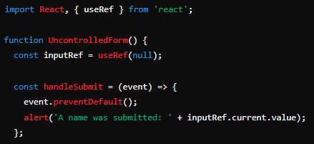
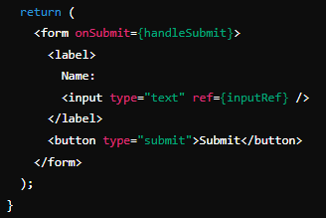
Uncontrolled Components
Definition
Components where form data is handled by the DOM itself
Advantages
Less code required for simple forms
Allows for integration with non-React code
Example
Using refs to handle input values

Slide 9


Slide 10

In a controlled component, how do you update the value of an input field?
By updating the React state using the setState function in the onChange event handler of the input field
How can you access the value of an uncontrolled input field?
By using a ref to get the current value from the DOM element
What is the main difference between controlled and uncontrolled components in React forms?
Controlled components manage form data through React state, while uncontrolled components rely on the DOM for data management

Slide 11

Task 1
Build a form with controlled components to capture and display user input
Task 2
Create a form with basic validation to ensure that all fields are filled before submission

